Slide 1
Finding blind faults using ground roll reflection
Craig Hyslop
Robert Stewart

Slide 2
Outline
Purpose
Process
Synthetics
Field data
Conclusions

Slide 3
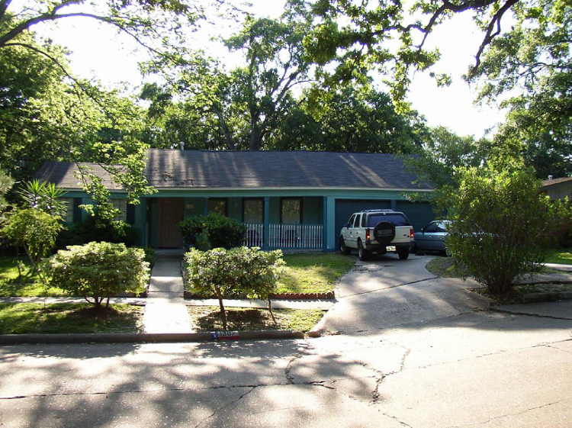
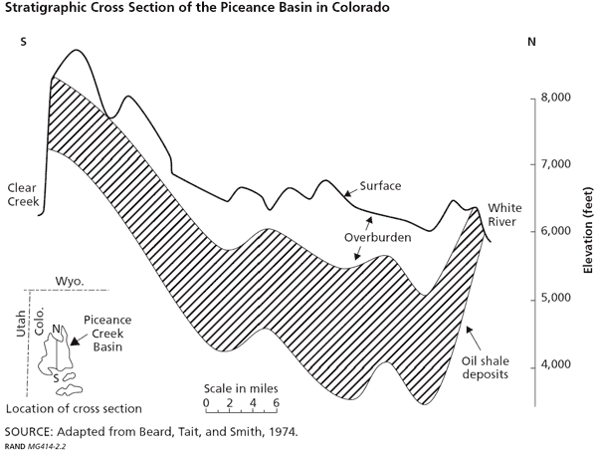
Purpose
Long Point Fault, Houston TX
Identification of blind faults
Depth: 0-50m
(Engelkemeir, 2006)
Exploration
Depth: 0-500m
500m

Slide 4
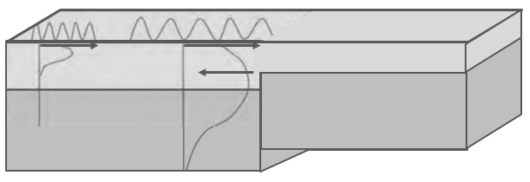
Ground roll reflection

Slide 5
A horizontal SP
Boundary 1
Boundary 2
Flattened
Enhanced
Subtracted
Shot record
distance
time
Deconvolved
Flattened/Stacked

Slide 6
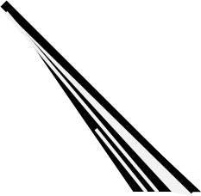
A horizontal SP
Free surface
Boundary 1
Boundary 2
Flattened
Enhanced
Subtracted
Shot record
distance
time
Deconvolved
Flattened/Stacked

Slide 7
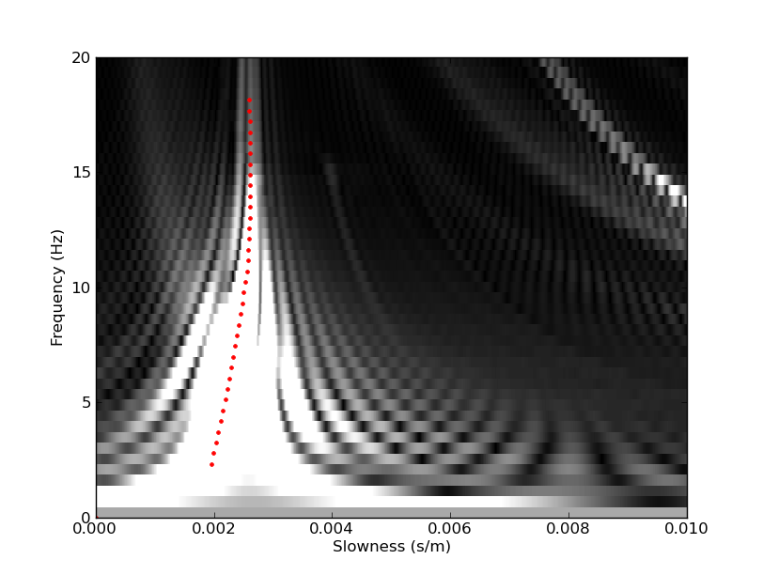
Compressing dispersive wave
MASW
Time
Time
500
250
167
125
100
Velocity (m/s)
Rel. amplitude
Rel. amplitude

Slide 8
Imaging
x
z
Model
Form Common Surface Location Gather
Width of the corridor stack
x
t’
Flattened, incoming shots

Slide 9
Imaging
x
z
Model
Form Common Surface Location Gather
Width of the corridor stack
Fourier transform
Mean of amplitude spectrum at each location
x
t’
Flattened, incoming shots

Slide 10
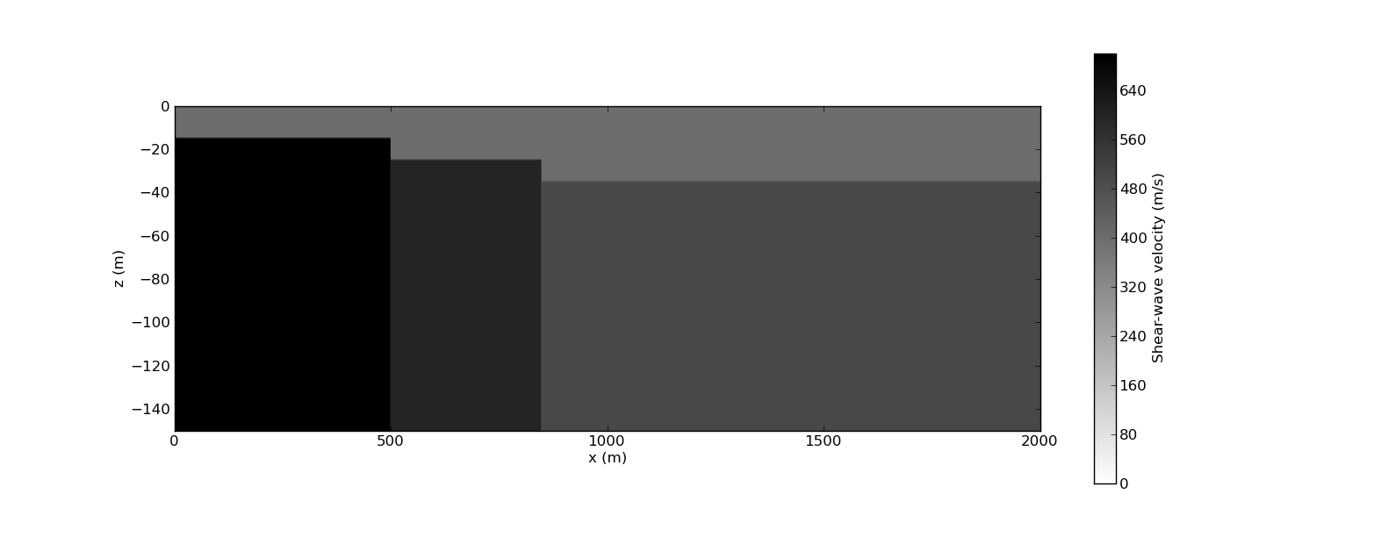
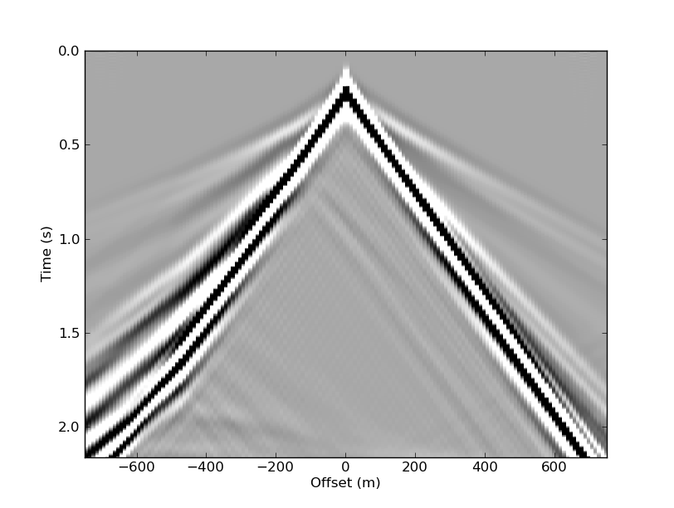
Synthetic, two faults
300m/s
700m/s
600m/s
500m/s
Model – 2000m wide
150 receivers @ 10m spacing: 250m -1750m
15 sources @ 100m spacing: 250m-1750m
- central frequency – 6Hz

Slide 11
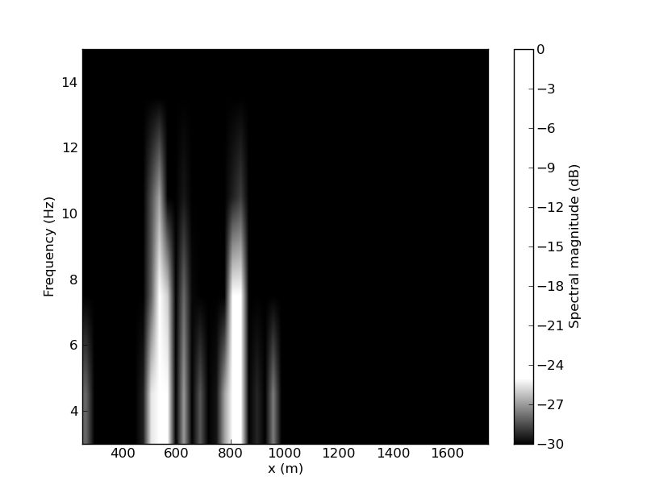
Synthetic, two faults
300m/s
700m/s
600m/s
500m/s
Higher frequencies are reflected from the shallow fault

Slide 12
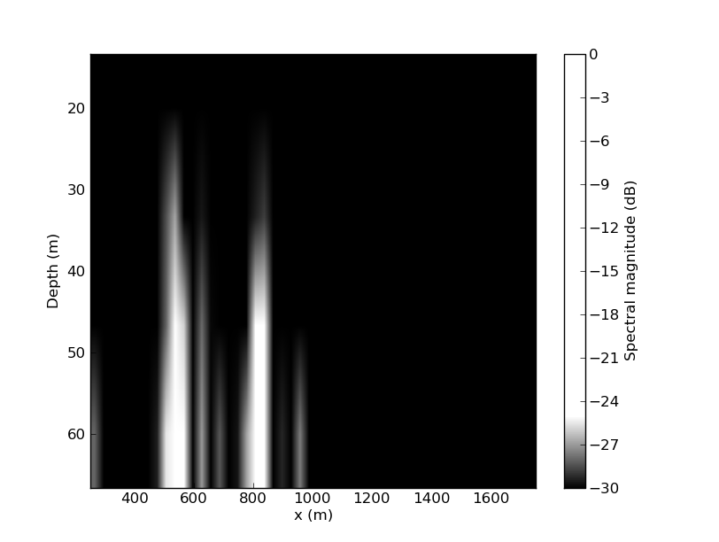
Synthetic, two faults
300m/s
700m/s
600m/s
500m/s
Dispersion curve used to convert to depth
$$d=λ/2=\frac{V/f}{2}$$

Slide 13
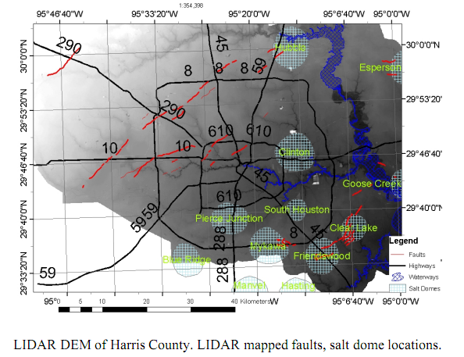
Field areas
Hockley Fault
Friendswood
(Engelkemeir, 2006)
Notes:
Dr. Khan
Houston has faults!
Two things going on:
1.) Sedimentation in the gulf causes loading on crust and the gulf coast subsides. Most of the faults here are down thrown towards the gulf
2.) Salt domes – plastic material, lighter and buoyant – press their way up in diapers through surrounding sediments -

Slide 14
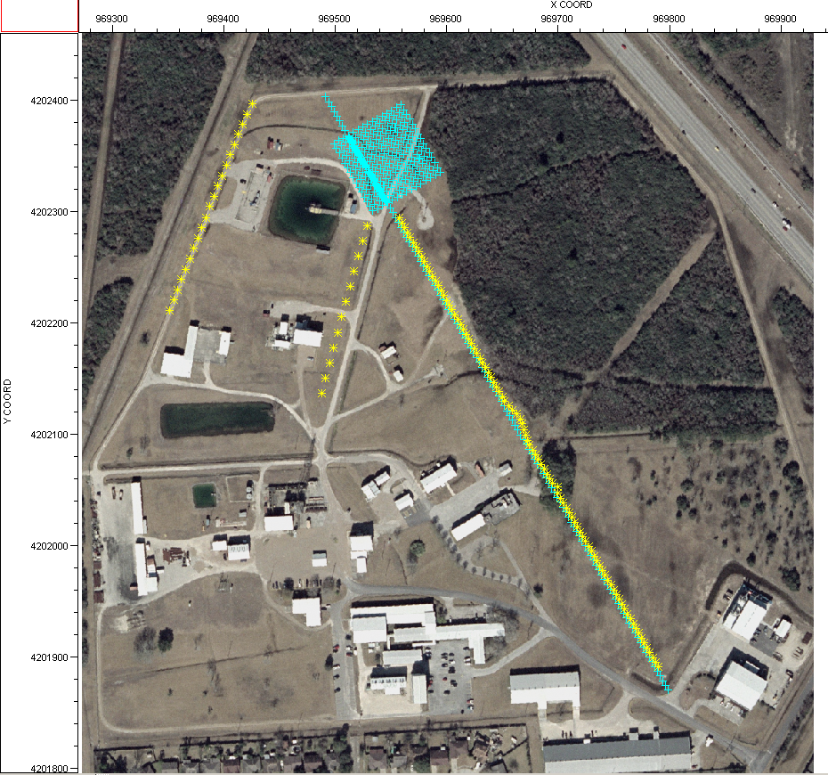
Friendswood
Equipment
120 Geophones @5m 2D
recorded @ 1ms
Sources
Vertical Vib (45000 lb) @5m
Cone Penetrometer (0-30m)
+
Geophones
Vert. Vib
CPT
*
Line 104

Slide 15
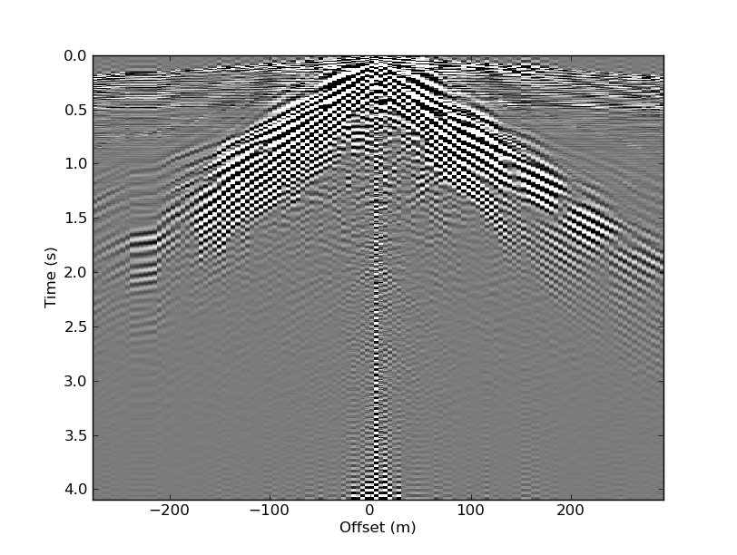
Friendswood: shot record

Slide 16
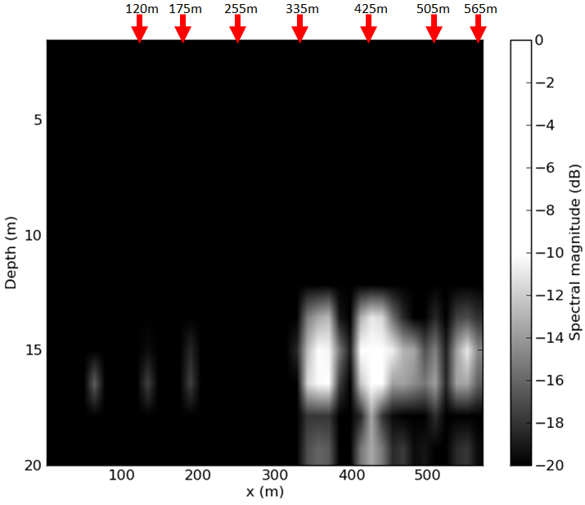
Friendswood: processed
CPT is measure of shear wave velocity
Map represents lateral amount of change in shear modulus
Note jump in CPT at 335m

Slide 17
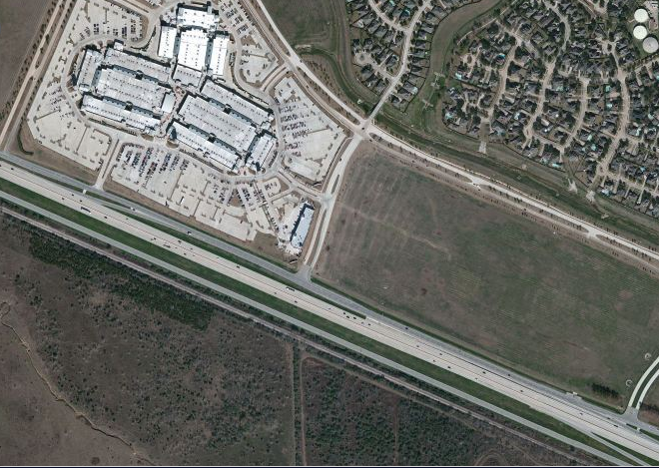
Hockley fault
Premium Outlet Mall
Equipment
216 geophones @5m
recorded @ 1ms
Sources
Vertical Vib @5m
Cracks on road reported
Hockley fault zone
Imagery Microsoft – available exclusively through DigitalGlobe

Slide 18
Hockley fault: shot record

Slide 19
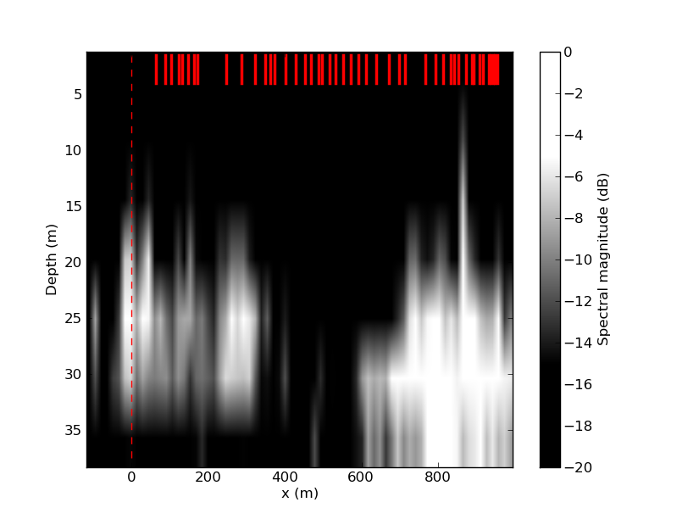
Hockley fault: processed
Location of fault indicated with dashed red line
Location of cracks on road indicated by red lines at top

Slide 20
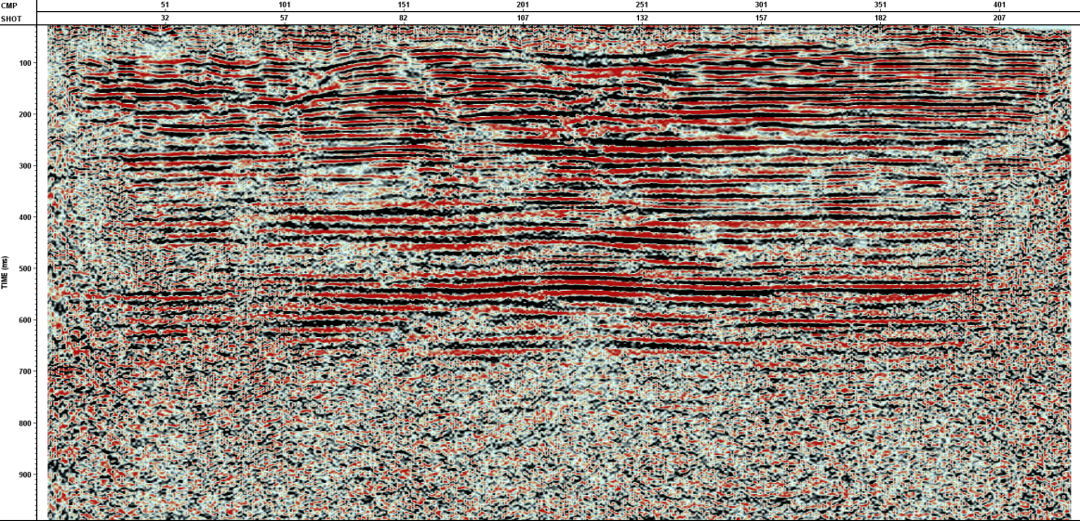
Hockley fault: brute stack

Slide 21
Conclusions
Unique reflectivity spectrum for differing depths of blind faults can be recovered from ground roll.
Processed Friendswood 2D line correlates with CPT data.
Processed 2D line over Hockley fault relates to crack locations and brute stack.

Slide 22
Aknowledgements
ExxonMobil for use of data from the Friendswood Test Facility

Slide 23
Thank you

